Slide 1
Software Engineering CS 487
Dennis Hood
Computer Science
Fall ‘19
Notes:
This template can be used as a starter file for presenting training materials in a group setting.
Sections
Right-click on a slide to add sections. Sections can help to organize your slides or facilitate collaboration between multiple authors.
Notes
Use the Notes section for delivery notes or to provide additional details for the audience. View these notes in Presentation View during your presentation.
Keep in mind the font size (important for accessibility, visibility, videotaping, and online production)
Coordinated colors
Pay particular attention to the graphs, charts, and text boxes.
Consider that attendees will print in black and white or grayscale. Run a test print to make sure your colors work when printed in pure black and white and grayscale.
Graphics, tables, and graphs
Keep it simple: If possible, use consistent, non-distracting styles and colors.
Label all graphs and tables.

Slide 2

Week 9
Software Evolution and Resilience
Notes:
This is another option for an Overview slides using transitions.

Slide 3
Lesson Overview
Evolution and Resilience
Reading
Ch. 9 – Software Evolution
Ch. 14 – Resilience Engineering
Objectives
Look at challenges associated with evolving software systems and approaches for dealing with them
Discuss system reengineering as a means for gaining insight into the design of legacy systems
Consider the concepts of resiliency and resilient engineering
Discuss cybersecurity in this context

Slide 4
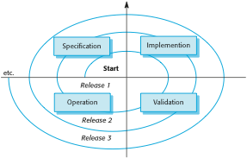
Software Evolution
Manage the inevitable change
Support and facilitate business growth
Take advantage of technology innovation
Evolve-release-evolve-release-…

Slide 5
Evolution Dynamics
Grow or progressively lose value (e.g., user satisfaction, perceived quality, etc.)
Evolution tends to increase complexity
Bigger systems tend to resist evolution
Organizational bureaucracy dampens evolution
The bigger the evolution the greater the number of associated problems

Slide 6
Managed Change
Formal change requests/proposals
Purpose and priority
Cost and effort
Risk assessment
Change review and authorization
Change control board
Change implementation
Software engineering
Planning and management
Change release
Communication
Rollback planning

Slide 7
Program Evolution Dynamics
Change is inevitable
As long as the system is used there will be demand to correct imperfections, improve shortcomings and add functionality
Change increases complexity
Adding to an existing structure tends to degrade stability
New functionality may bring new defects
Change tends to be regulated by factors such as system and organization size
Big systems are more difficult to change
Bureaucracies impede change

Slide 8
Maintenance
Development effort and discipline should reduce maintenance effort and cost
Better analysis will result in a better alignment with user needs
Better design and implementation will reduce defects (including user confusion, etc.)
More thorough QA will minimize defects in production
The evolutionary approach can be result in higher maintenance costs
Adding functionality to an existing system is more difficult
This issue should be countered by planning evolutions well in advance where possible
Change should be managed with discipline
Defect removal
Enhancements

Slide 9
Drivers of Maintenance Activity
Interfaces
Number and complexity matter
User and system interfaces
Information
Number of data sources
Data structure complexity
Volatile requirements
Policies and procedures
Business rules
Technology
Processes utilizing the system
The more users, the more demand for change

Slide 10
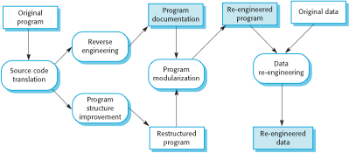
Reengineering to Gain Understanding
Benefits
Creates a newer, more maintainable version
Faster and cheaper than building brand new

Slide 11
Refactoring
Preventive maintenance thru occasional touching up to stave off degradation
Improve structure and performance
Reduce complexity
Improve understandability, etc.
Improve what’s already there, don’t add new functionality
Targets for refactoring improvement
Removal of duplicate code
Decomposing long methods
Simplify or replace “switch” statements
Encapsulate recurring “clumps” of data
Remove speculative generality

Slide 12
Legacy Systems
Systems supporting critical business systems may hang around for a while
Change is risky
Need downtime to switch over
Domain knowledge seeps away over time
Possible next steps
Scrap it
Leave it as is and maintain
Reengineer it to improve maintainability
Replace all or at least some of it
Assess business value vs. system quality

Slide 13
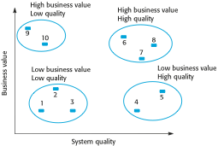
Legacy System Evaluation

Slide 14
Sociotechnical Systems
Systems consist of both software and hardware, and operate within an environment which includes users, partners and other systems
The sociotechnical systems stack
Social
Organizational
Business process
Application
Communications and data management
Operating system
Equipment

Slide 15
Resilience
The ability to withstand stress to the point of complete recovery
The resiliency of a system therefore refers to its ability to continue to provide services as specified, even under the stress of disruptive events (e.g., equipment failures, user errors, cyberattacks, etc.)
Failure happens – best be able to handle it
There is an implied priority given to critical services
We would benefit from an extension which includes resilience in the face of change

Slide 16
Exception Handling
Resilient engineering is focused on the detection of, response to, and recovery from exceptional conditions
Resilient activities
Recognition – an adequate degree of awareness
Resistance – early detection may allow for “fighting off” the condition
Recovery – timely restoration of (especially critical) systems to minimize disruption
Reinstatement – return to normal operation

Slide 17
Cybersecurity
Our current massively interconnected environment offers many paths for opportunistic would-be invaders
Adequately securing system functions and sensitive data has been always been a (non-functional) requirement
Increasingly this has extended to cybersecurity – maintaining adequate security in a networked environment

Slide 18
Security Controls
Authentication
Forcing users to prove that they are authorized to access assets
Encryption
Altering the form of sensitive data to the point that unauthorized users would not be able to understand or make use of it
Firewalls
Protective checkpoints for restricting traffic flow to only trusted sources

